Slide 1
One word to rule them all:
ἀνακύκλωσις

Slide 2
I. What is Anacyclosis?
Many republics died to bring us this information.

Slide 3
Anacyclosis is the cover page of political history.
There is the moral of all human tales;
'Tis but the same rehearsal of the past,
First Freedom, and then Glory -- when that fails,
Wealth, vice, corruption, -- barbarism at last.
And History, with all her volumes vast,
Hath but one page.
Lord Byron, Childe Harold’s Pilgrimage, Canto IV, CVIII, 1818.

Slide 4
The Matrix has you. And me. And everyone else.
The Ancient Greeks reduced the variations of political society to a matrix of archetypes by multiplying a quantitative aspect (number of rulers) by a qualitative aspect (the beneficiaries of such rule):
 | Public gain | Private gain
One rules | Kingship | Tyranny
Few rule | Aristocracy | Oligarchy
Many rule | Democracy | Ochlocracy (mob rule)

Slide 5
Anacyclosis is the probable sequence through the Greek archetypes.
The first of these to come into being is monarchy, its growth being natural and unaided; and next arises kingship derived from monarchy by the aid of art and by the correction of defects. Monarchy first changes into its vicious allied form, tyranny; and next, the abolishment of both gives birth to aristocracy. Aristocracy by its very nature degenerates into oligarchy; and when the commons inflamed by anger take vengeance on this government for its unjust rule, democracy comes into being; and in due course the licence and lawlessness of this form of government produces mob-rule to complete the series.
Polybius, Histories, c. 133 BC.

Slide 6
Sure enough, the cities of Greece evolved in accordance with Anacyclosis.
Monarchies (kingship or tyranny) were the most common regime type from 700 BC until around 450 BC.
Then, oligarchy was the most common regime until around 350 BC.
Finally, democracies were the most common regime from 350 BC until the conquests of Macedonia and Rome.
Based on the data presented by David Teegarden, Death to Tyrants!, Princeton University Press, 2013.

Slide 7
That said, few republics live long enough to see the end of Anacyclosis.
Such is the circle which all republics are destined to run through. Seldom, however, do they come back to the original form of government, which results from the fact that their duration is not sufficiently long to be able to undergo these repeated changes and preserve their existence. But it may well happen that a republic lacking strength and good counsel in its difficulties becomes subject after a while to some neighboring state, that is better organized than itself; and if such is not the case, then they will be apt to revolve indefinitely in the circle of revolutions.
Machiavelli, Discourses on Livy, c. 1517.

Slide 8
But superpower republics survive until Anacyclosis ends them.
When a state has weathered many great perils and subsequently attains to supremacy and uncontested sovereignty, it is evident that under the influence of long established prosperity, life becomes more extravagant and the citizens more fierce in their rivalry regarding office and other objects than they ought to be. As these defects go on increasing, the beginning of the change for the worse will be due to love of office and the disgrace entailed by obscurity, as well as to extravagance and purse-proud display … When this happens, the state will change its name to the finest sounding of all, freedom and democracy, but will change its nature to the worst thing of all, mob rule.
Polybius, Id.

Slide 9
In Rome, uncontested sovereignty was prelude to uncontrollable faction.
When our country had grown great through toil and the practice of justice, when great kings had been vanquished in war, savage tribes and mighty peoples subdued by force of arms, when Carthage, the rival of Rome's sway, had perished root and branch, and all seas and lands were open, then Fortune began to grow cruel and to bring confusion into all our affairs.
Sallust, Conspiracy of Catiline, c. 44 BC.

Slide 10
Rome was the first superpower republic to consummate Anacyclosis.
753 BC: Rome at the beginning was ruled by kings.
509 BC: Aristocrats expelled the last tyrant.
494 BC: Commoners begin agitating against Patrician aristocracy.
396 BC: Rome achieves first significant conquest (Veii).
287 BC: The Patrician aristocracy was eclipsed by moneyed oligarchy.
267 BC, 133 BC: Democratic laws promoting rationing of land passed (Lex Licinia Sextia, Lex Sempronia Agraria).
241 BC: Rome acquires first province (Sicily).
146 BC: Rome defeats Carthage, achieving Mediterranean hegemony.
123 BC: Grain dole established (Lex Frumentaria, Cura Annonae).
107 BC-27 BC: Violent populist agitation/conservative reaction occurs.
27 BC: The entire Mediterranean Basin submits to imperial monarchy.

Slide 11
The consummation of Anacyclosis entails two separate but related processes:
First, an internal revolutionary sequence pursuant to which political power is ultimately concentrated in the monarchy of a single person.
Second, an external process of territorial integration pursuant to which territory is consolidated under the hegemony of a single state.
In Antiquity, both processes were consummated in the person of Gaius Julius Caesar Octavianus, Imperator Caesar Augustus.

Slide 12
Anacyclosis is so hot right now. It has been since Antiquity. See:
Plato, Republic, c. 375 BC (specifically referenced by Polybius).
Aristotle, Nicomachean Ethics, c. 350 BC.
Panaetius/Deimachus (in the Scipionic Circle – possibly Polybius’ source).
Polybius, Histories, c. 133 BC (the author of Anacyclosis).
Sallust, Conspiracy of Catiline, c. 44 BC.
Dionysius, Roman Antiquities, 7 BC.
Pomponius, Digest of Justinian, 530 AD.
Niccolo Machiavelli, Discourses on Livy, c. 1517.
Francesco Sansovino, Propositioni Overo Considerationi, 1583.
Charles I, Answer to the Nineteen Propositions, 1642.
John Adams, An Essay on Man’s Lust for Power, 1763.
John Adams, Defence of the Constitutions, 1787.

Slide 13
II. What makes democracy grow?
οἱ μέσοι! οἱ μέσοι! οἱ μέσοι!

Slide 14
Every human society is spring-loaded for Anacyclosis. Just add wealth.
If one man be sole landlord of a territory … his empire is absolute monarchy.
If the few or a nobility … be landlords … the empire is mixed monarchy...
And if the whole people be landlords … the empire … is a commonwealth.
James Harrington, Commonwealth of Oceana, 1656.

Slide 15
The diffusion of wealth dictates the diffusion of political power.
Power always follows Property. This I believe to be as infallible a Maxim, in Politicks, as, that Action and Re-action are equal, is in Mechanicks.
John Adams, letter to James Sullivan, 1776.
Wherever we cast our eyes, we see this truth, that property is the basis of power.
Noah Webster, An Examination into the Leading Principles of the Federal Constitution, 1787.

Slide 16
Where enough wealth is diffused to create a middle class, democracy is born.
The power of consent does not rest on the fantasy that it is given, but in the possibility that it be withheld.
In all of history, there has only existed one people’s agency which could sustain a challenge the elite status quo.
It was the financially independent, self-sufficient middle classes, what Aristotle called the οἱ μέσοι, or hoi mesoi.

Slide 17
But not just any middle class. An independent middle class.
In the general course of human nature, a power over a man's subsistence amounts to a power over his will.
Alexander Hamilton, Federalist No. 79, 1788.

Slide 18
Moderate fortunes produce modest customs and middling virtues.
The middle amount of all of the good things of fortune is the best amount to possess. For this degree of wealth is the readiest to obey reason, whereas for a person who is exceedingly beautiful or strong or nobly born or rich, or the opposite—exceedingly poor or weak or of very mean station, it is difficult to follow the bidding of reason. … And moreover the middle class are the least inclined to shun office and to covet office, and both these tendencies are injurious to states. And in addition to these points, those who have an excess of fortune’s goods, strength, wealth, friends and the like, are not willing to be governed and do not know how to be.
Aristotle, Politics, c. 350 BC.

Slide 19
The middle class is the counterweight to political faction.
There are three classes of citizens. The first are rich, who are indolent and yet always crave more. The second are the poor, who have nothing, are full of envy, hate the rich, and are easily led by the demagogues. Between the two extremes lie those who make the state secure and uphold the laws.
Euripides, Suppliants, 423 BC.

Slide 20
Democracy is a contract between the elites and middle class.
The essential needs of every state are military and fiscal, to support the powers of the sword and of the purse.
Accordingly, the democracies of Antiquity arose from military labor strikes, while modern democracy commenced in a tax revolt.
Power concedes nothing without a demand. It never did and it never will.
Frederick Douglass, speech at Canandaigua, New York, 1857.

Slide 21
So that’s why democracy is historically rare. Independent middle classes are rare.
Democracy has only occurred in two waves in history.
The first wave crashed in the Mediterranean Basin around the 6th century BC, yielding over 300 ancient democracies.
The second wave crashed along the North Atlantic around the 18th century AD, yielding over 100 modern democracies.
The emergence of a large middle class of independent farmers preceded the first appearance of democracy in both waves.

Slide 22
The processes which drive Anacyclosis are everywhere at work.
The diffusion of wealth advances the sequence of Anacyclosis. Conflict over the distribution of wealth exists in every society.
Inferiors revolt in order that they may be equal, and equals that they may be superior. Such is the state of mind which creates revolutions.
Aristotle, Id.

Slide 23
The first stages of Anacyclosis are thus common.
Most of history chronicles the turmoil and wars of monarchies and dynasties in every portion of Earth.
Almost all people who were ever born lived and died as the subjects of kings, nobles, dictators, and military juntas.
Periods of democracy are found in less than one-tenth of recorded history since the Mesopotamians and Egyptians.

Slide 24
Few examples of democracy mean few complete examples of Anacyclosis.
Because wealth is rarely diffused widely enough to sustain an independent middle class, the final stages of Anacyclosis are rare.
Anacyclosis has only advanced to the democratic stage in those states adhering to Classical Antiquity and Western Civilization.
On reviewing the English history, we observe a progress similar to that in Rome—an incessant struggle for liberty from the date of Magna Charta, in John’s reign, to the revolution. The struggle has been successful, by abridging the enormous power of the nobility. But we observe that the power of the people has increased in an exact proportion to their acquisitions of property.
Noah Webster, Id.

Slide 25
III. At last, democracy is no more.
Everything that has transpired has done so according to Polybius’ design.

Slide 26
If wealth diffusion summons democracy, what does wealth concentration summon?
Political faction, of course.
The most common and durable source of factions, has been the various and unequal distribution of property.
James Madison, Federalist No. 10, 1787.

Slide 27
Late-stage democracy endows political faction with specific characteristics.
Middle class stagnation and decline engenders a novel sense of idleness and precariousness among the general population.
Precariousness and idleness, in turn, amplify the preexisting animosities and dependencies of the body politic.
Populist leaders appropriate democratic institutions to advance campaigns serving the interests of animosity and dependency.

Slide 28
Animosity and dependency are the poles in polarization.
As the middling virtues erode, political movements and parties increasingly cluster around the twin poles of animosity and dependency.
The faction rallying around the pole of dependency tends to associate with the left side of the spectrum, directing blame toward the wealthy.
The faction rallying around the pole of animosity tends to associate with the right side of the spectrum, directing blame toward foreigners and the poor.

Slide 29
The Romans knew that the concentration of wealth destroyed their republic.
Roman writers after the collapse of the Republic were … united in believing that the operative factor throughout was a moral failure arising from the increase of wealth: this had led the governing class to seek riches and power without scruple, while at the same time economic inequality had made the lower classes desperate and ready for any crime against the state.
A. W. Lintott, Violence in Republican Rome, Oxford Press, 1968.

Slide 30
Some Romans even saw it coming a hundred years away.
The wild beasts that roam over Italy have every one of them a cave or lair to lurk in; but the men who fight and die for Italy enjoy the common air and light, indeed, but nothing else; houseless and homeless they wander about with their wives and children. And it is with lying lips that their imperators exhort the soldiers in their battles to defend sepulchres and shrines from the enemy; for not a man of them has an hereditary altar, not one of all these many Romans an ancestral tomb, but they fight and die to support others in wealth and luxury, and though they are styled masters of the world, they have not a single clod of earth that is their own.
Tiberius Gracchus, 133 BC, quoted in Plutarch, Parallel Lives, c 100 BC.

Slide 31
The Roman elites annihilated their own middle classes.
After having pillaged the world as praetors or consuls during time of war, the nobles again pillaged their subjects as governors in time of peace; and upon their return to Rome with immense riches they employed them in changing the modest heritage of their fathers into domains vast as provinces.
Victor Duruy, History of the Romans from the Most Ancient Times up to the Death of Theodosius, 1874.

Slide 32
In retrospect, it is obvious. No hoi mesoi, no democratic republic.
The republic had been at the outset, and for several centuries afterward, a commonwealth of free landowners. This great middle class was now swept out of existence, and with it went the foundation on which the state rested. The object of the movement connected with the name of Tiberius Gracchus was to build this class up again.
Frank Frost Abbott, A History and Description of Roman Political Institutions, Ginn & Company, 1901.

Slide 33
Avarice and ambition murdered the Roman republic.
Avarice destroyed honour, integrity, and all other noble qualities; taught in their place insolence, cruelty, to neglect the gods, to set a price on everything. Ambition drove many men to become false; to have one thought locked in the breast, another ready on the tongue; to value friendships and enmities not on their merits but by the standard of self-interest, and to show a good front rather than a good heart. At first these vices grew slowly, from time to time they were punished; finally, when the disease had spread like a deadly plague, the state was changed and a government second to none in equity and excellence became cruel and intolerable.
Sallust, Id.

Slide 34
The founders feared that America could suffer the same fate.
The alternate domination of one faction over another, sharpened by the spirit of revenge, natural to party dissension, which in different ages and countries has perpetrated the most horrid enormities, is itself a frightful despotism. But this leads at length to a more formal and permanent despotism. The disorders and miseries which result gradually incline the minds of men to seek security and repose in the absolute power of an individual; and sooner or later the chief of some prevailing faction, more able or more fortunate than his competitors, turns this disposition to the purposes of his own elevation, on the ruins of public liberty.
George Washington, Farewell Address, 1796.

Slide 35
It looks like America is well on its way.
The Census Bureau does not have an official definition of the "middle class," but it does derive several measures related to the distribution of income and income inequality….Generally, the long-term trend has been toward increasing income inequality.
U.S. Census Bureau, Narrative on Income Inequality (Middle Class), 2010.
In the late 20th century—after many decades of relative stability—the labor share began to decline in the United States and many other economically advanced nations, and in the early 21st century it fell to unprecedented lows.
U.S. Bureau of Labor Statistics, Estimating the U.S. labor share, 2017.

Slide 36
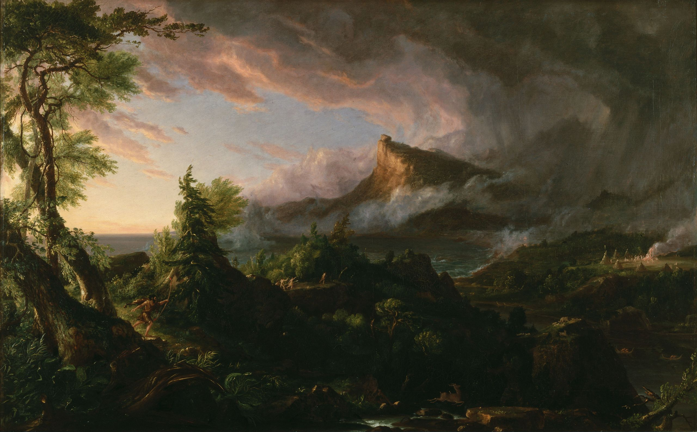
There is the moral of all human tales;
'Tis but the same rehearsal of the past,
First Freedom…
Thomas Cole, The Course of Empire, The Arcadian or Pastoral State, 1836.

Slide 37
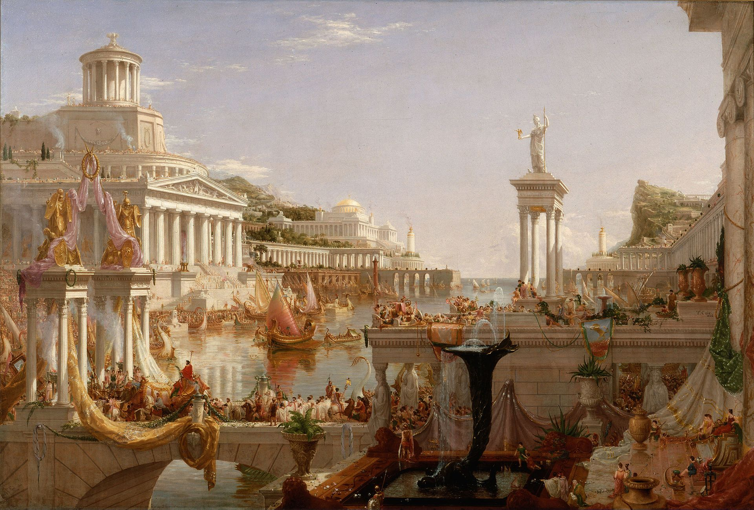
Thomas Cole, The Course of Empire, The Consummation, 1836.
…And then Glory -- when that fails,
Wealth, vice, corruption…

Slide 38
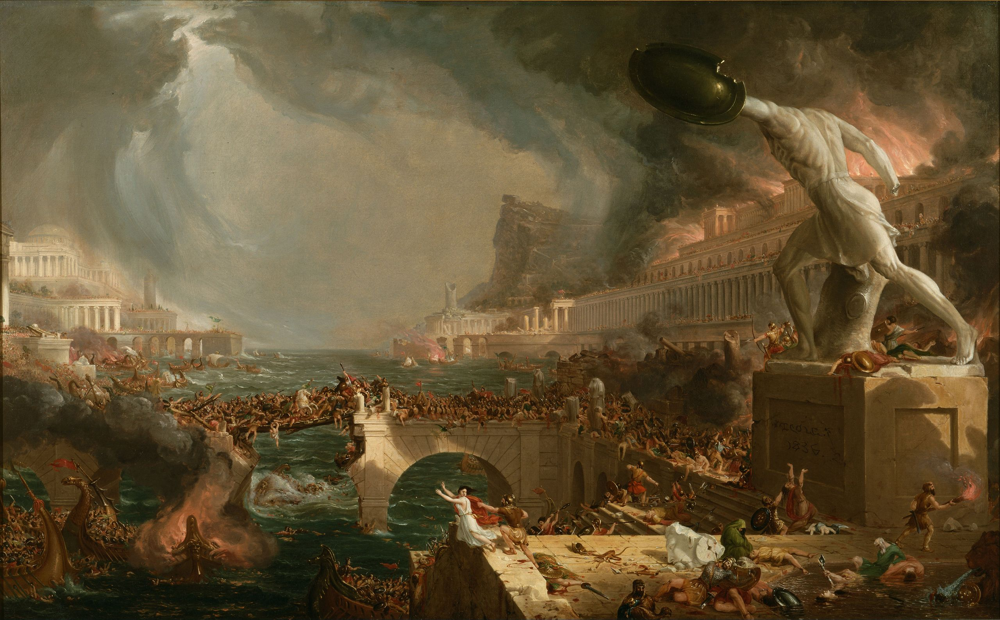
Thomas Cole, The Course of Empire, Destruction, 1836.
…Barbarism at last.
And History, with all her volumes vast…

Slide 39
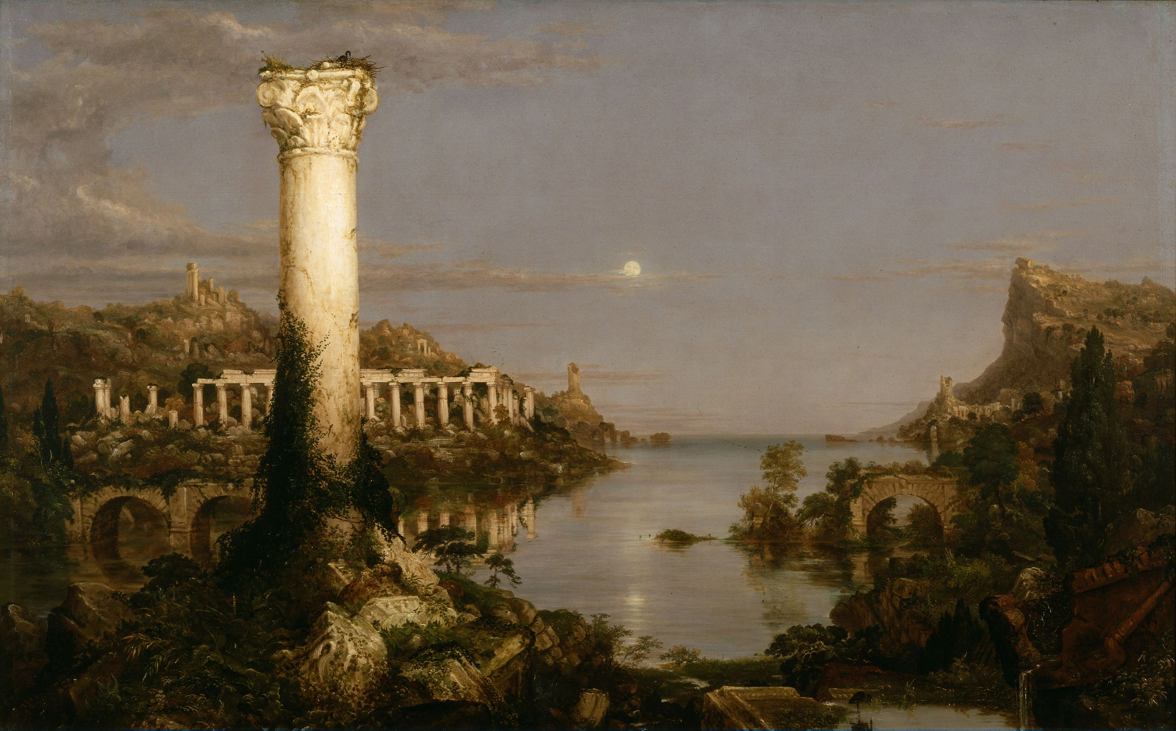
…Hath but one page.
Thomas Cole, The Course of Empire, Desolation, 1836.

Slide 40
Would you like to know more?
www.anacyclosis.org

